Slide 1
ADO.NET
Lecturer: Ngo Huy Bien
Software Engineering Department
Faculty of Information Technology
VNUHCM - University of Science
Ho Chi Minh City, Vietnam
nhbien@fit.hcmus.edu.vn

Slide 2

Objectives
To present what are software applications.
To present how to develop software applications.

Slide 3

References
Bill Hamilton and Matthew MacDonald. ADO.NET in a Nutshell. O'Reilly. 2003.

Slide 4
Prerequisites
C#
.NET Framework
MS SQL Server
T-SQL

Slide 5
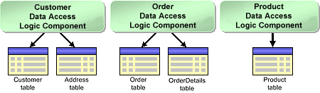
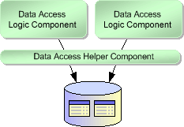
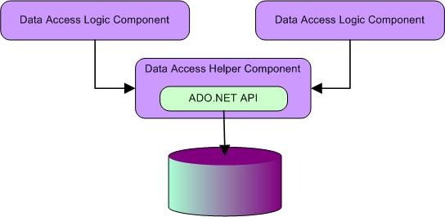
Data Access Component
Application database, database schema, stored procedure.
Data access frameworks: ADO.NET Entities and LINQ, NHibernate, Castle ActiveRecord…

Slide 6
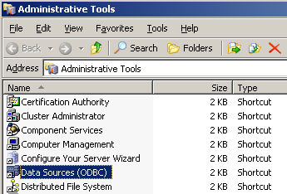
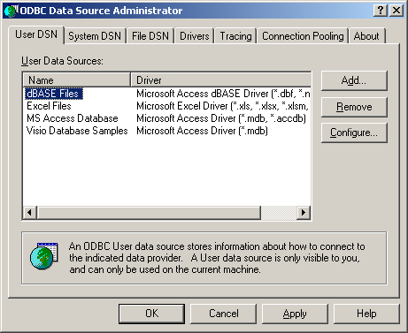
Open DataBase Connectivity (ODBC)
Call Level Interface (CLI) to a relational database
C-style interface
VB support?
Object – oriented support?

Slide 7
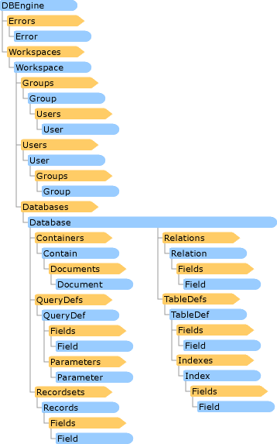
Data Access Object (DAO)
VB support.
Object – oriented support
Use Access's internal "Jet" (Joint Engine Technology)
Performance overhead?
Distributed, componentized, COM support?

Slide 8
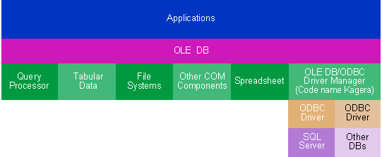
Object Linking and Embedding Database (OLE-DB)
COM – based interface for working with data
Support for non-relational stores and components
“Low level" interface that used pointers, explicit memory management, and explicit lifetime control
Wrapper for VB

Slide 9
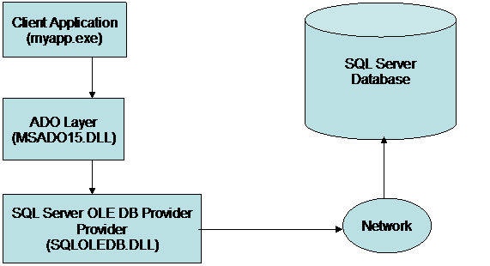
ActiveX Data Objects (ADO)
Follow DAO model
Advanced local cursor engine

Slide 10
ADO.NET [1]
ADO.NET is a new programming model built upon the .NET Framework, sharing a common type system, design patterns and naming conventions.
ADO.NET is designed to provide consistent access to data sources.
This is accomplished through ADO.NET data providers that provide methods for connecting to data sources as well as retrieving, manipulating, and updating data in both connected and disconnected environments.

Slide 11

Benefits
Disconnected (offline) data architecture in addition to supporting connected operation.
XML support.
A variety of data sources through a common data representation.
Data source access optimization.
language-independent, managed framework

Slide 12
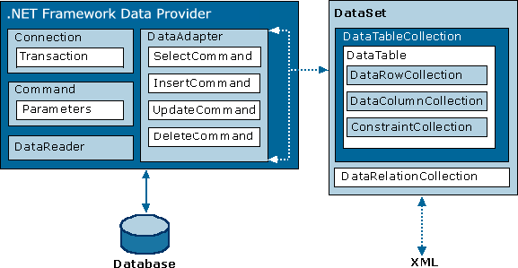
ADO.NET Architecture

Slide 13
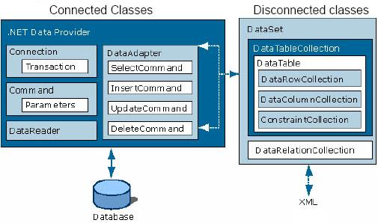
Connected and Disconnected ADO.NET classes

Slide 14
Data Providers
Microsoft SQL Server.
OLE DB.
ODBC.
Oracle.
SQLXML Managed Classes.
MySQL, Firebird, PostgreSQL, TurboDB, Sybase.

Slide 15

Connection
ConnectionString property.
ConnectionTimeout property.
Open method.
Close method.
State property.

Slide 16
Connection Pooling
Reusing active database connections instead of creating a new connection.
Connect Timeout, Pooling, Max Pool Size, Min Pool Size.
Connection leak.
Monitoring connection pooling behavior.

Slide 17

Command
CommandText property.
CommandType property.
Parameters property.
ExecuteNonQuery method.
ExecuteReader method.
ExecuteScalar method.

Slide 18
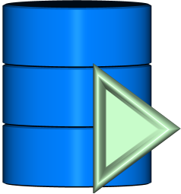
DataReader
Read method.
NextResult method.
Close method.

Slide 19
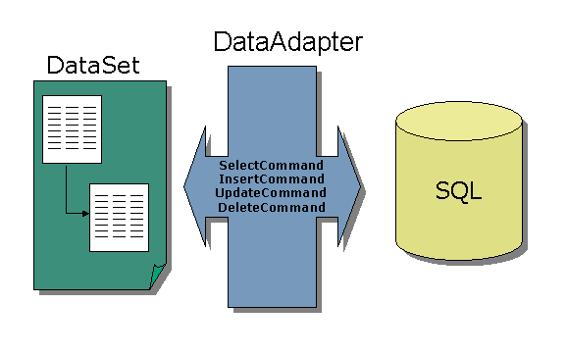
DataAdapter
ConnectionString, ConnectionTimeout property.
Fill, Update method.

Slide 20

DataSet
Memory-resident representation of data.
DataTable.
DataColumn.
DataRow.
Constraint (UniqueConstraint, ForeignKeyConstraint).
DataRelation.

Slide 21
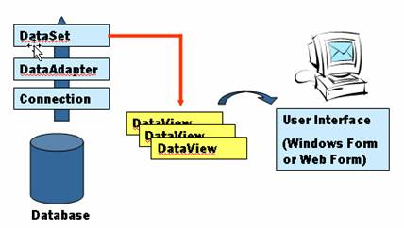
DataView
A logical table built from 1 or more tables.
Sorting, Filtering, Searching.

Slide 22
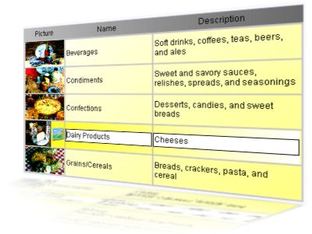
Data Binding
Displaying data without writing any code .
DataSource property.
DataBind method.

Slide 23
ASP.NET Data Binding

Slide 24

Transaction
BeginTransaction method of a Connection object.
Rollback method.
Commit method.

Slide 25
Database Publishing Wizard
http://products.secureserver.net/products/hosting/PublishingWithDPW.htm

Slide 26

Thank You & See You Again

